Slide 1
Creating Page Layouts w/CSS: Grid
CSCI 185, Spring 2023 Intro to Computer Programming for the Web

Slide 2
Outline
Overview
CSS Units
Media Queries
CSS Grid

Slide 3
Outline
Overview
CSS Units
Media Queries
CSS Grid

Slide 4
CSS & Layouts
Layouts are the hardest thing about CSS for many reasons:
The language has many, many different layout ‘paradigms’ for doing the same thing.
Specifying the rules for arranging boxes the right way is difficult
You have to design for several different browser configurations (what looks good on a desktop doesn’t necessarily look good on mobile).
Everything has to be flexible and resizable so that it scales gracefully.

Slide 5
Layout Tips
Learn CSS Grid (Today) – also worth the investment
Learn Flexbox (Next Wednesday) – it’s worth the investment!
Design your website so that it is responsive (looks good on a mobile, tablet, and desktop). Using Flexbox and CSS Grid will help you with mobile layouts.
Avoid older hacks (floats, putting everything inside a table, absolute positioning) – or else use as a last resort.
We’ll go through some examples today and next Wednesday.

Slide 6
Outline
Overview
CSS Units
Media Queries
CSS Grid

Slide 7
CSS Units: Absolute Units
Units | Example
Pixels | width: 300px;
Points | font-size: 12pt;
https://codepen.io/vanwars/pen/PoeYGJo?editors=0100

Slide 8
CSS Units: Relative Units
Units | Description | Example
em | Relative to the font-size of the parent element (2em means 2 times the parent element’s font size). | font-size: 2em;
rem | Relative to font-size of the root html element (2rem means 2 times the html element’s font size).. See em v. rem CodePen. | font-size: 2rem;
fr | “Fractional units” of the available space (within the parent element). | grid-template-columns: 1fr 1fr 40px 20%;
vw | Relative to 1% of the width of the viewport (size of browser window) | width: 30vw;
vh | Relative to 1% of the height of the viewport (size of browser window) | width: 10vw;
% | Relative to the parent element | width: 100%;
https://codepen.io/vanwars/pen/PoeYGJo?editors=0100

Slide 9
Outline
Overview
CSS Units
Media Queries
CSS Grid

Slide 10
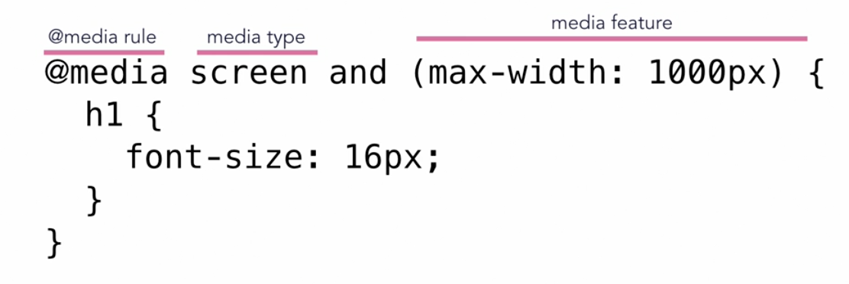
Using Media Queries
Media queries allow you to set CSS style rules based on the type of media and the device dimensions of the viewport. Example:

Slide 11
“Turning On” Media Queries in your HTML
In order to make sure that media queries are honored, you need to include a meta tag in the <head></head> of your html file:
<meta name="viewport" content="width=device-width, initial-scale=1.0">

Slide 12
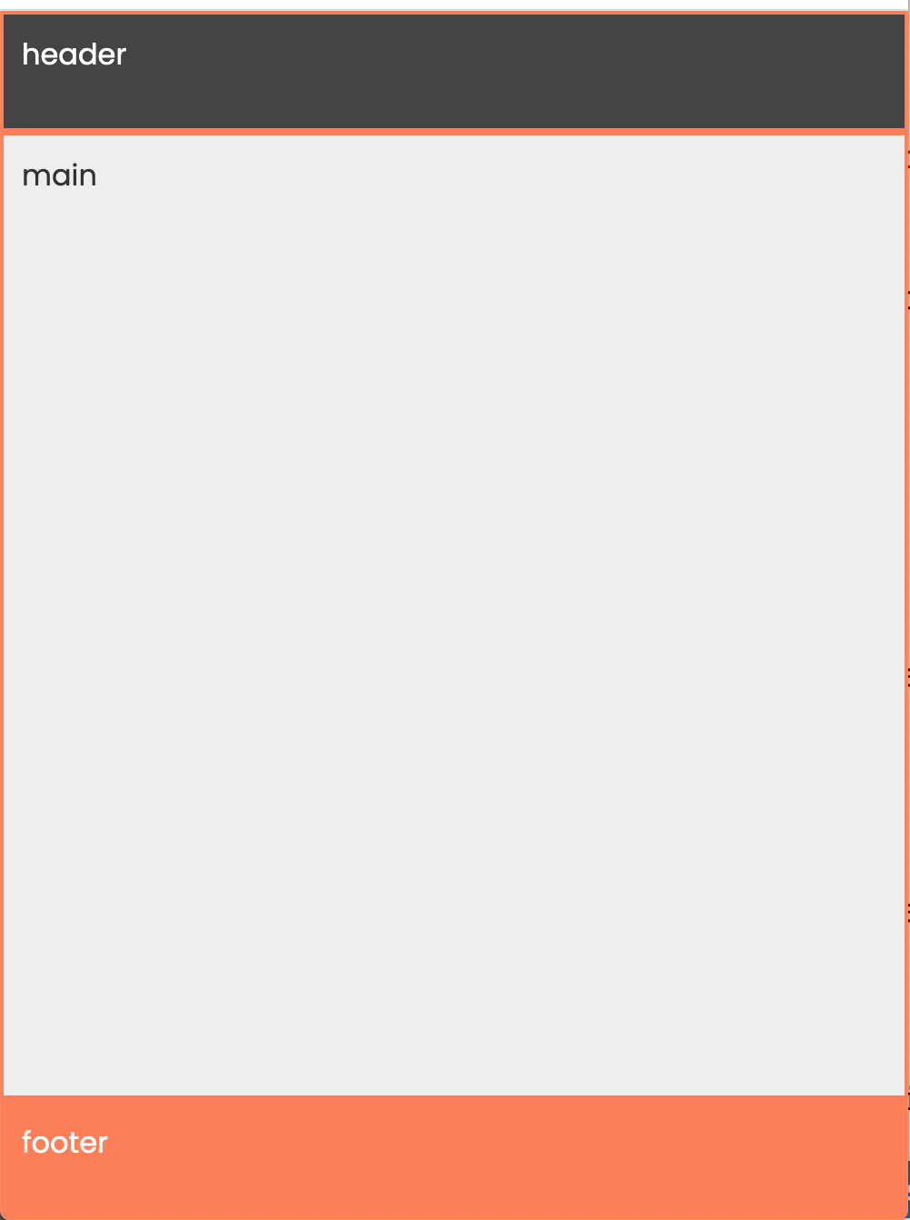
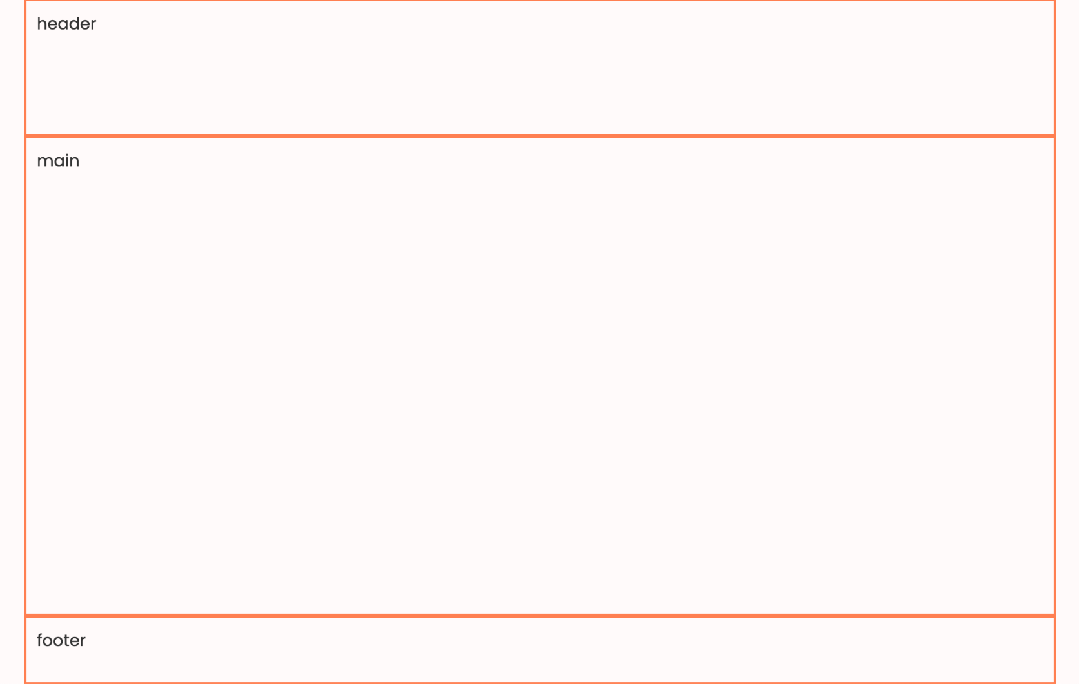
Practice: 00-media-query
Tablet or Mobile
Desktop

Slide 13
Outline
Overview
CSS Units
Media Queries
CSS Grid

Slide 14
CSS Grid
Give you control over how your website is laid out in both the horizontal and vertical directions.
Key grid properties for parent (grid container):
display (should be set to grid).
grid-template-rows
grid-template-columns
grid-template-areas
row-gap and column-gap
Key grid properties for children (grid items):
grid-column-start
grid-column-end (with or without span keyword)
grid-area

Slide 15
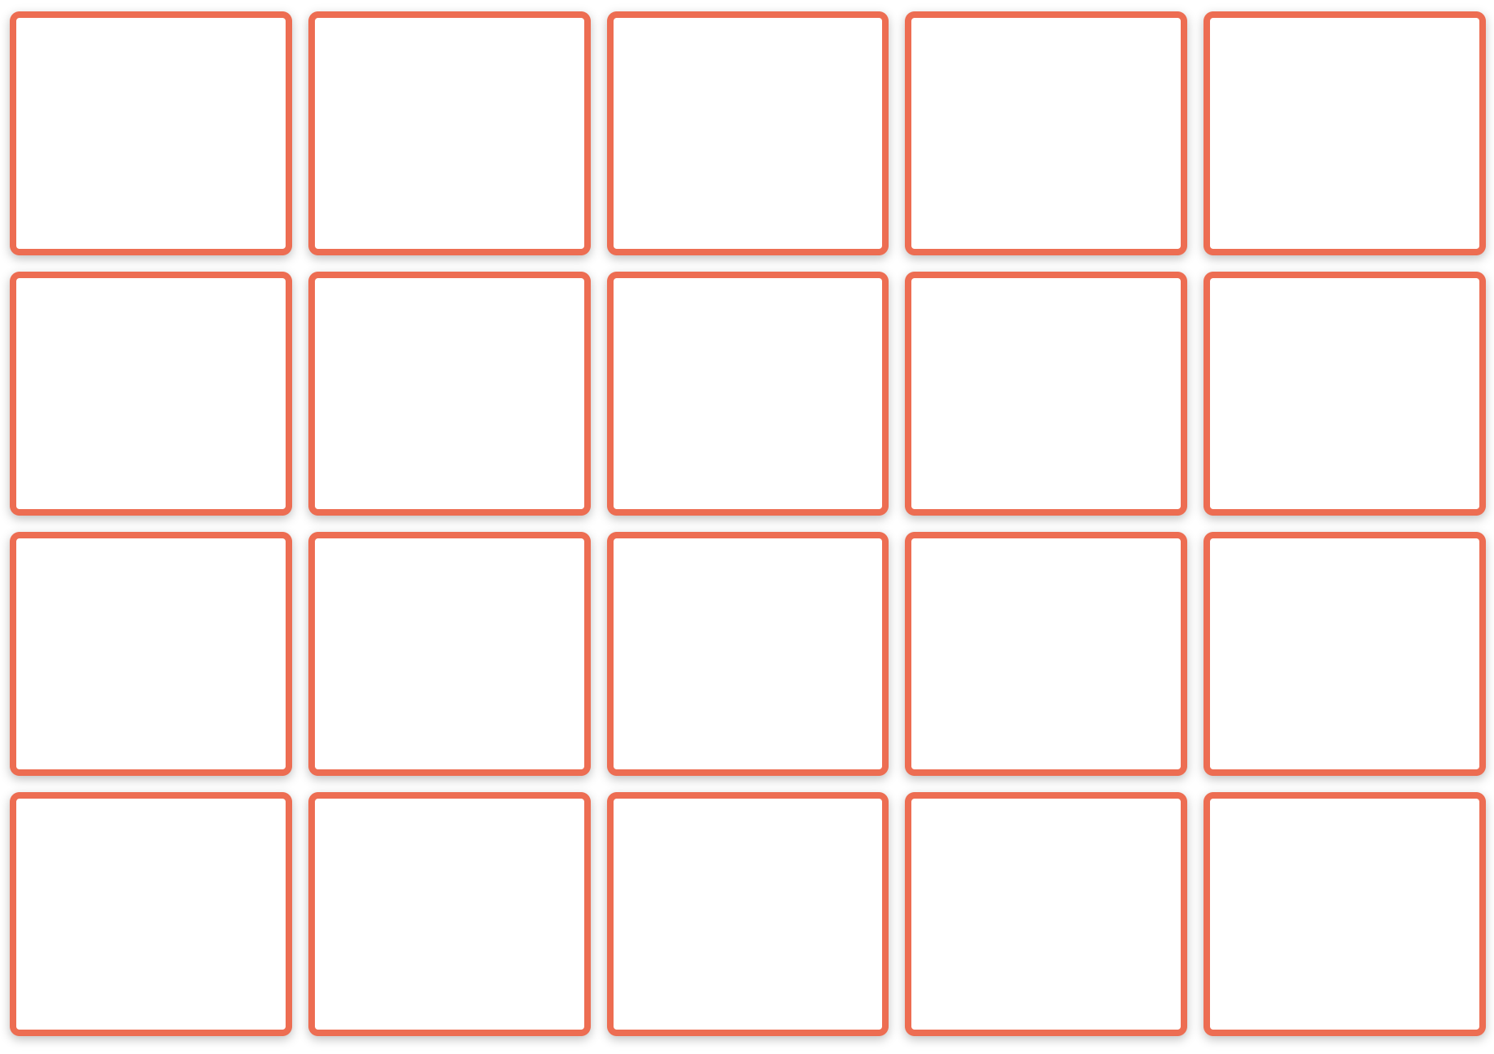
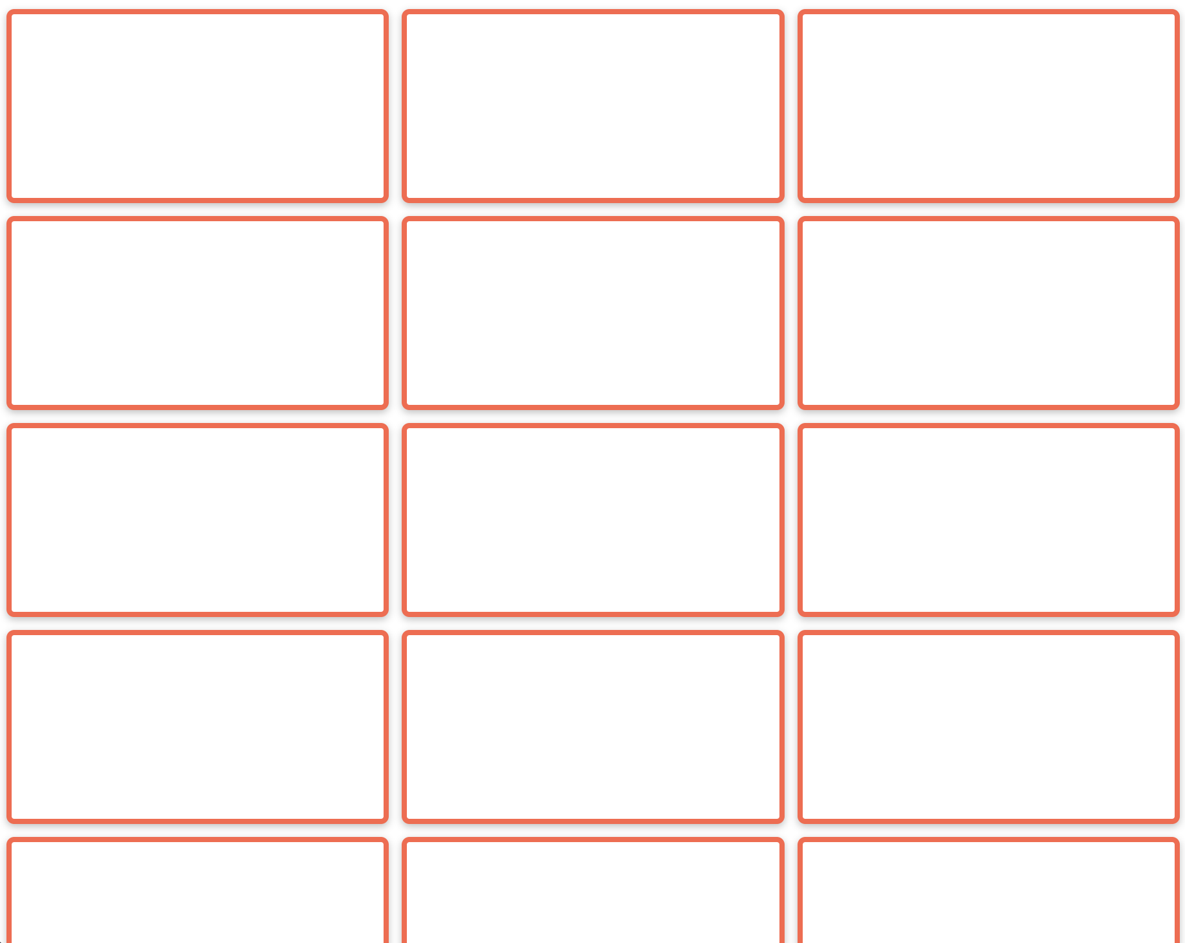
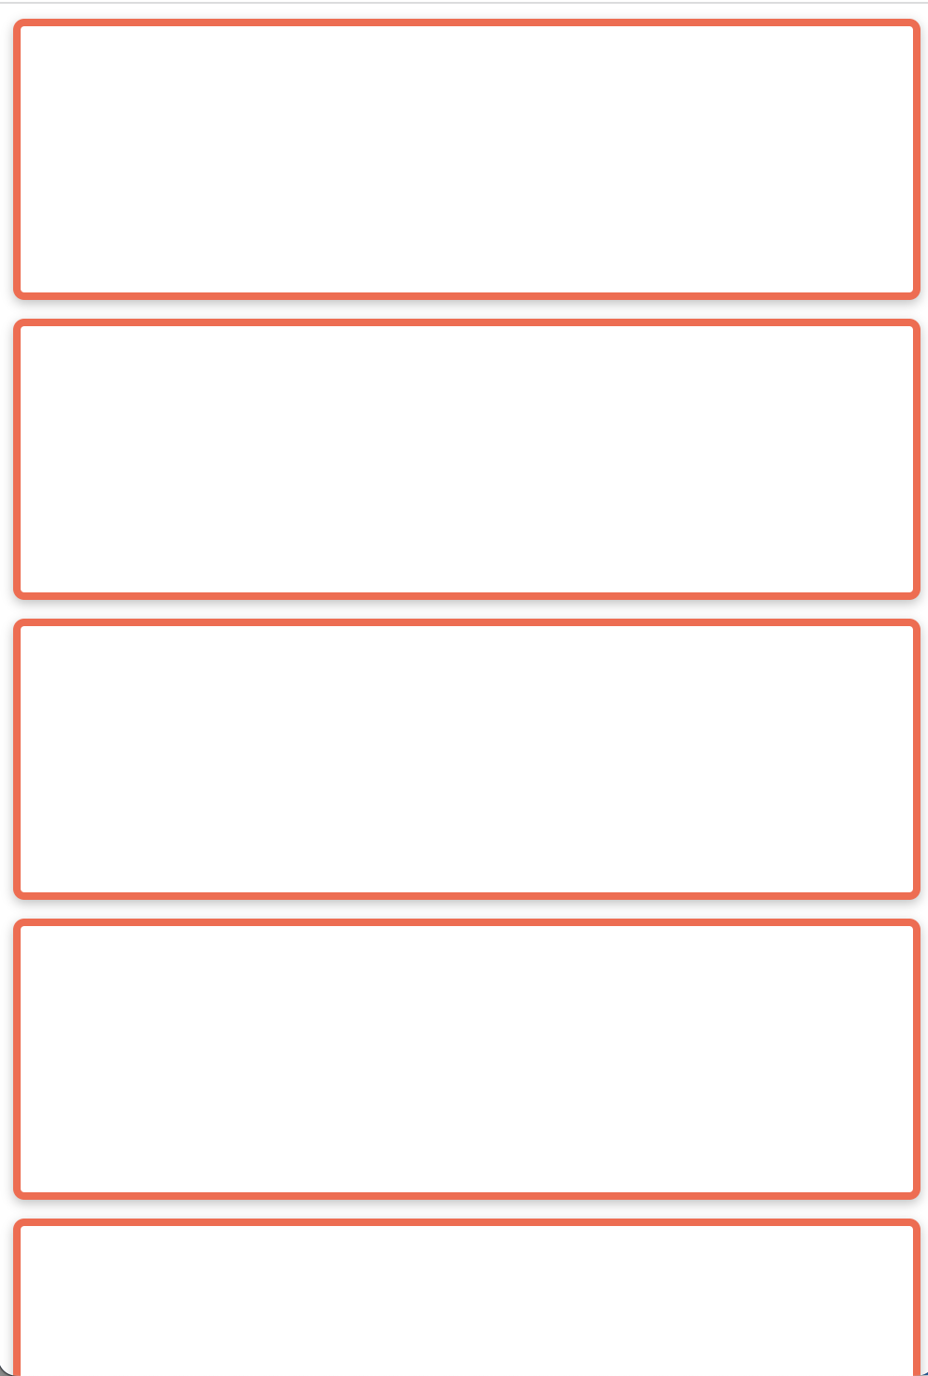
Exercise 1: Create this Layout (01-columns)
Desktop
Tablet
Mobile

Slide 16
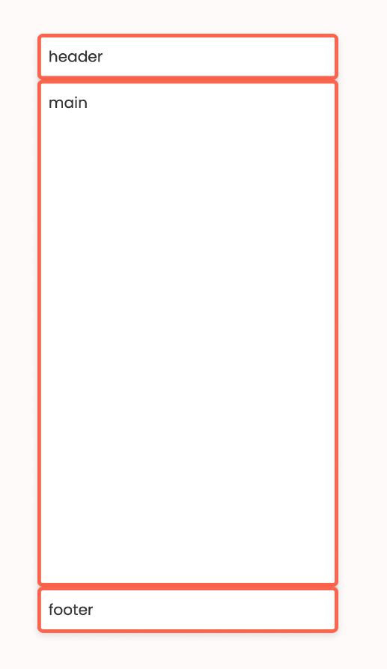
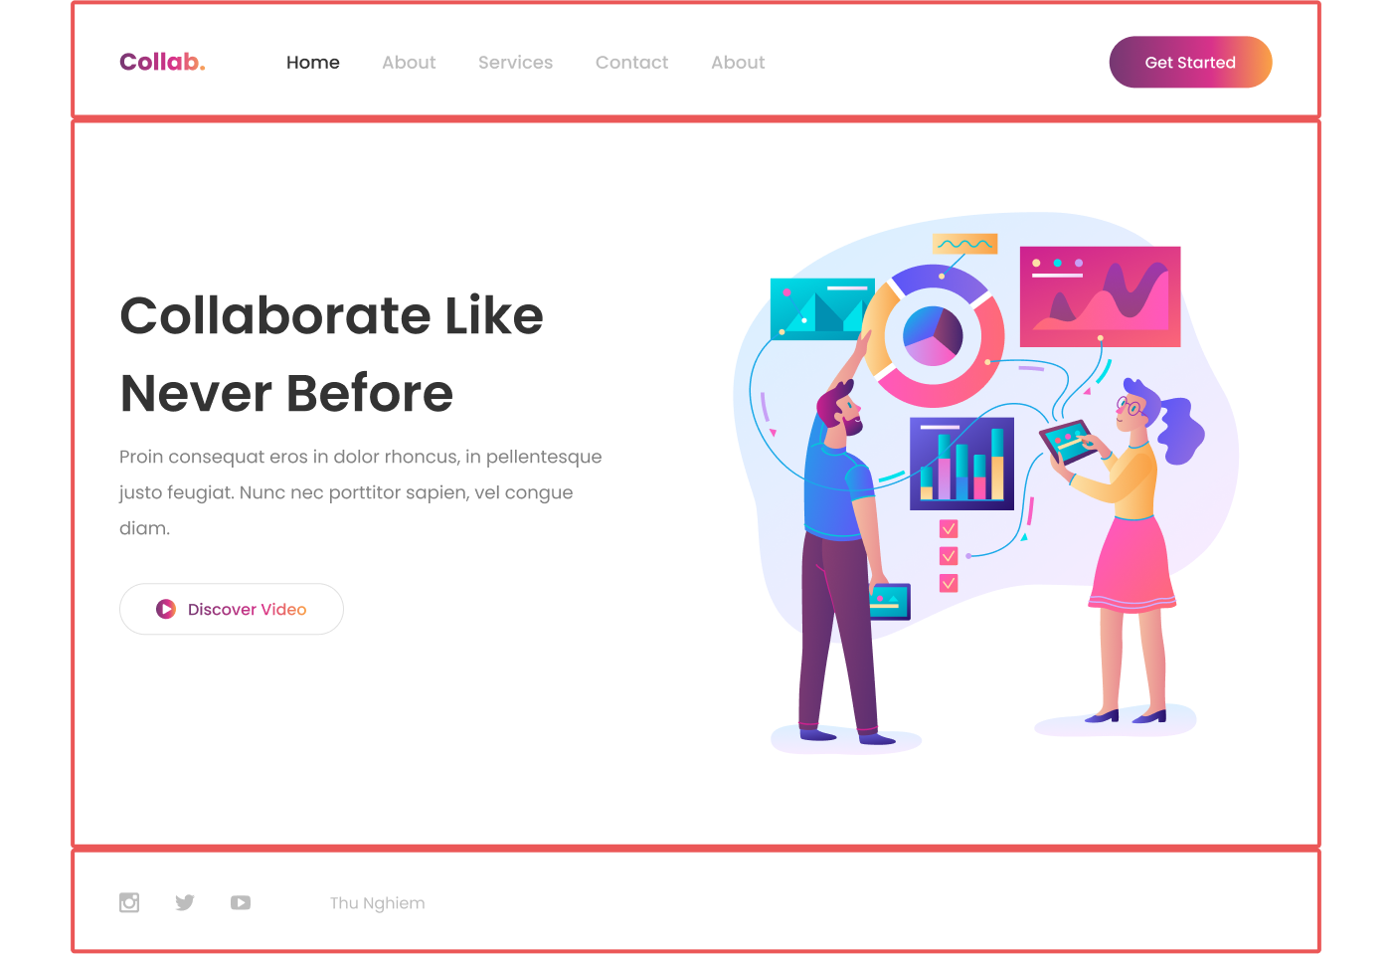
Exercise 2: Create this Layout (02-rows)

Slide 17
Exercise 2: Create this Layout (02-rows)
Use grid-template-rows on the parent element:
If you want 3 rows, specify the width of each row!
# of rows corresponds to number of children

Slide 18
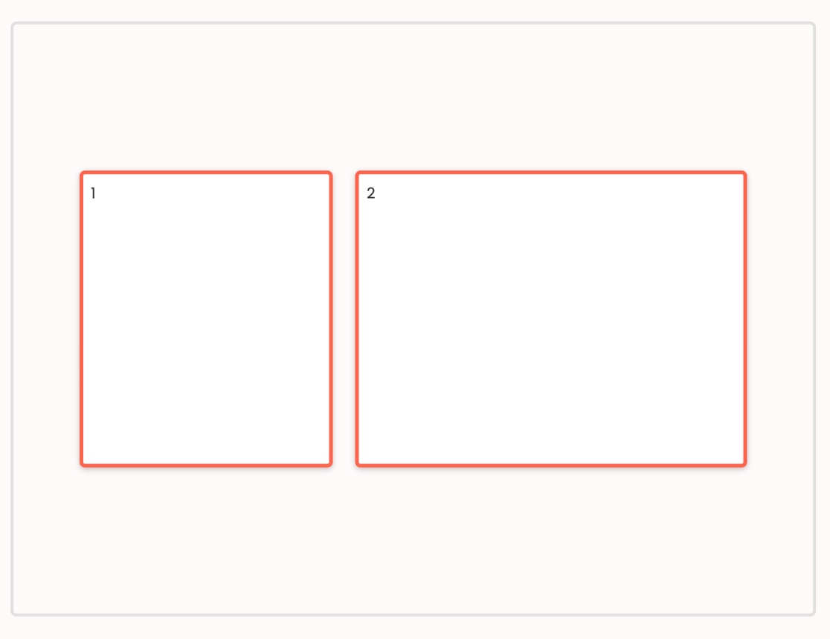
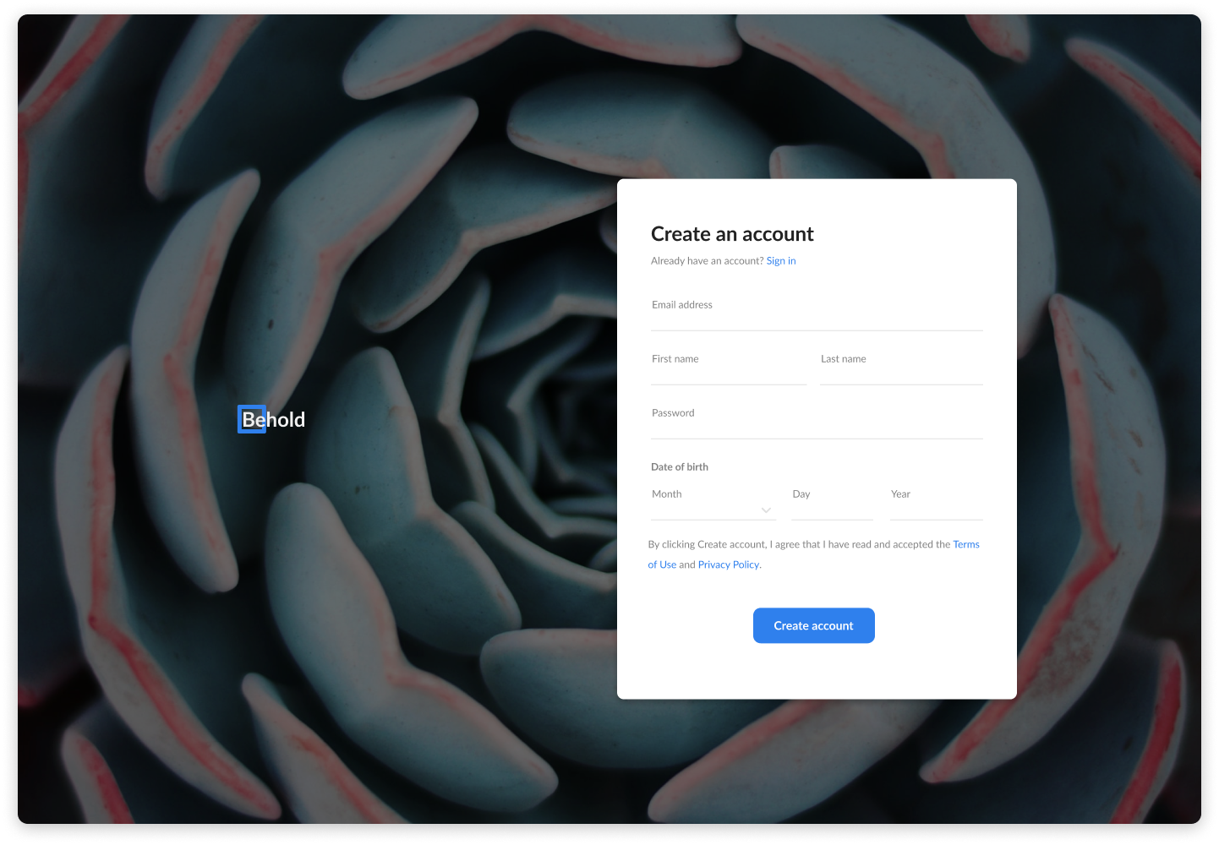
Exercise 3: Create this Layout (03-twelve-column-grid)
First child should span columns 2-5, second child should span columns 6-11

Slide 19
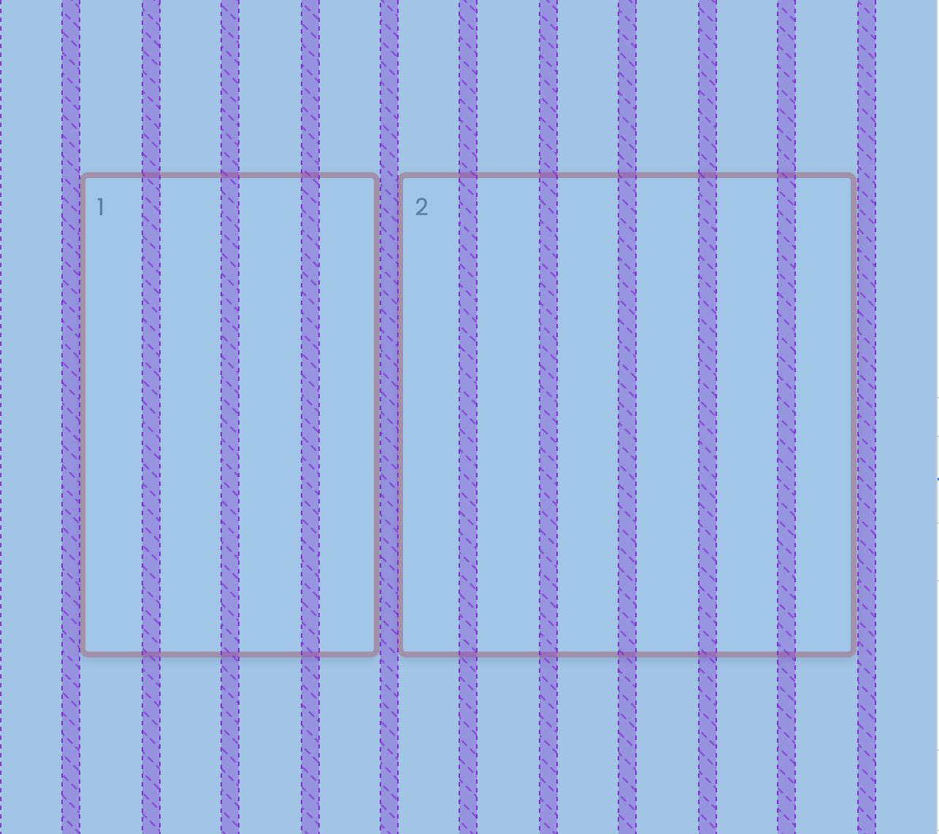

Slide 20
Exercise 3: Create this Layout (03-twelve-column-grid)
Use grid-template-columns on the parent element (12, equal width columns):
Tip: use the “repeat” shortcut: repeat(12, 1fr);
Use grid-column-start and grid-column-end on the child elements
.item-1 {
grid-column-start: 2;
grid-column-end: span 4;
}

Slide 21
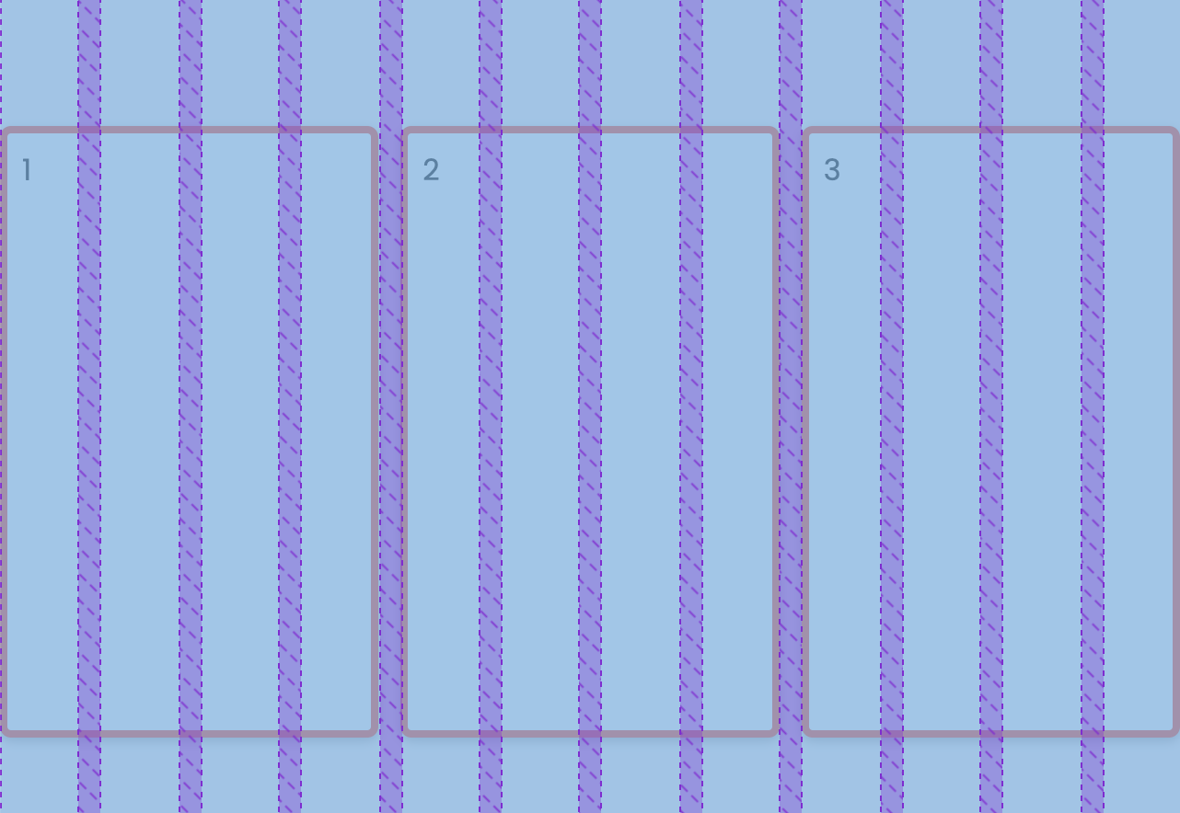
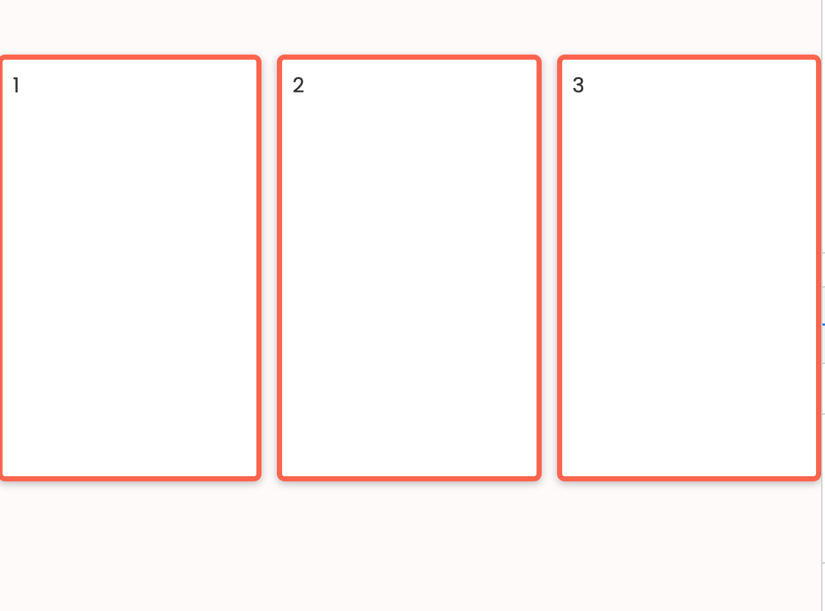
Challenge: How could you make this diagram?

Slide 22
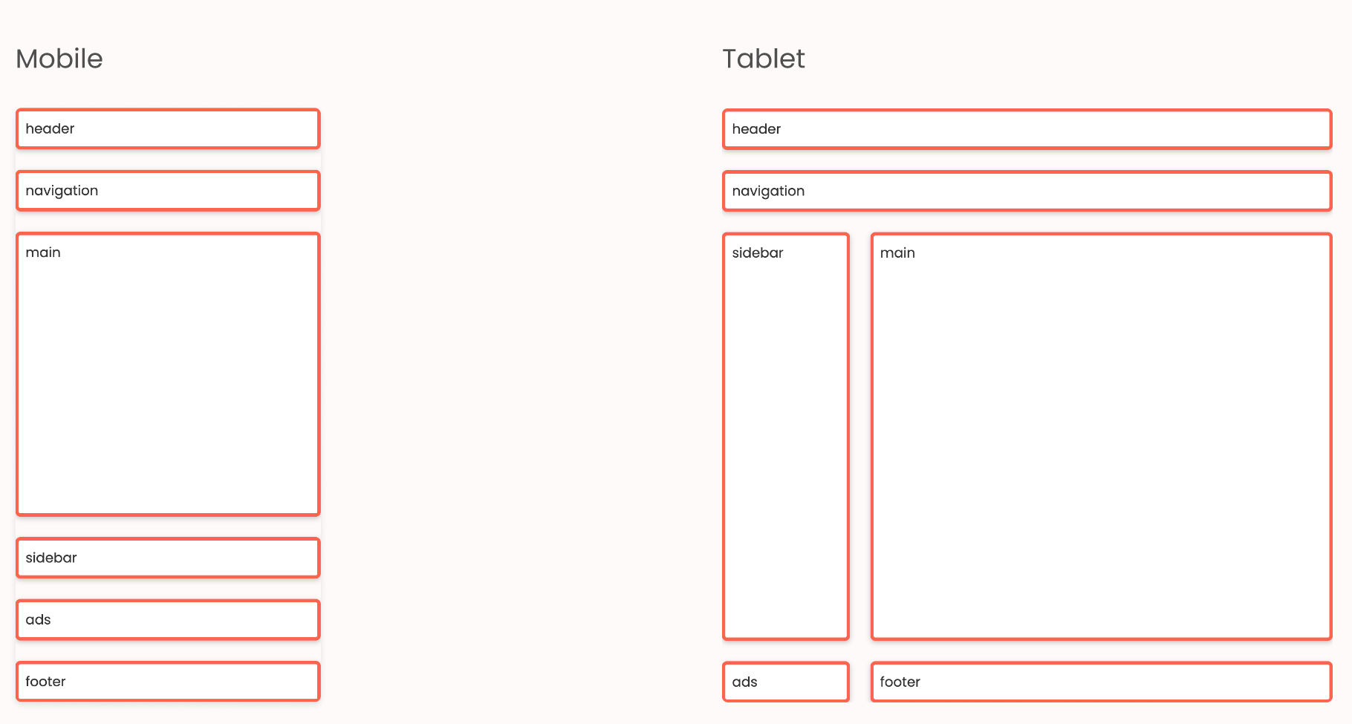
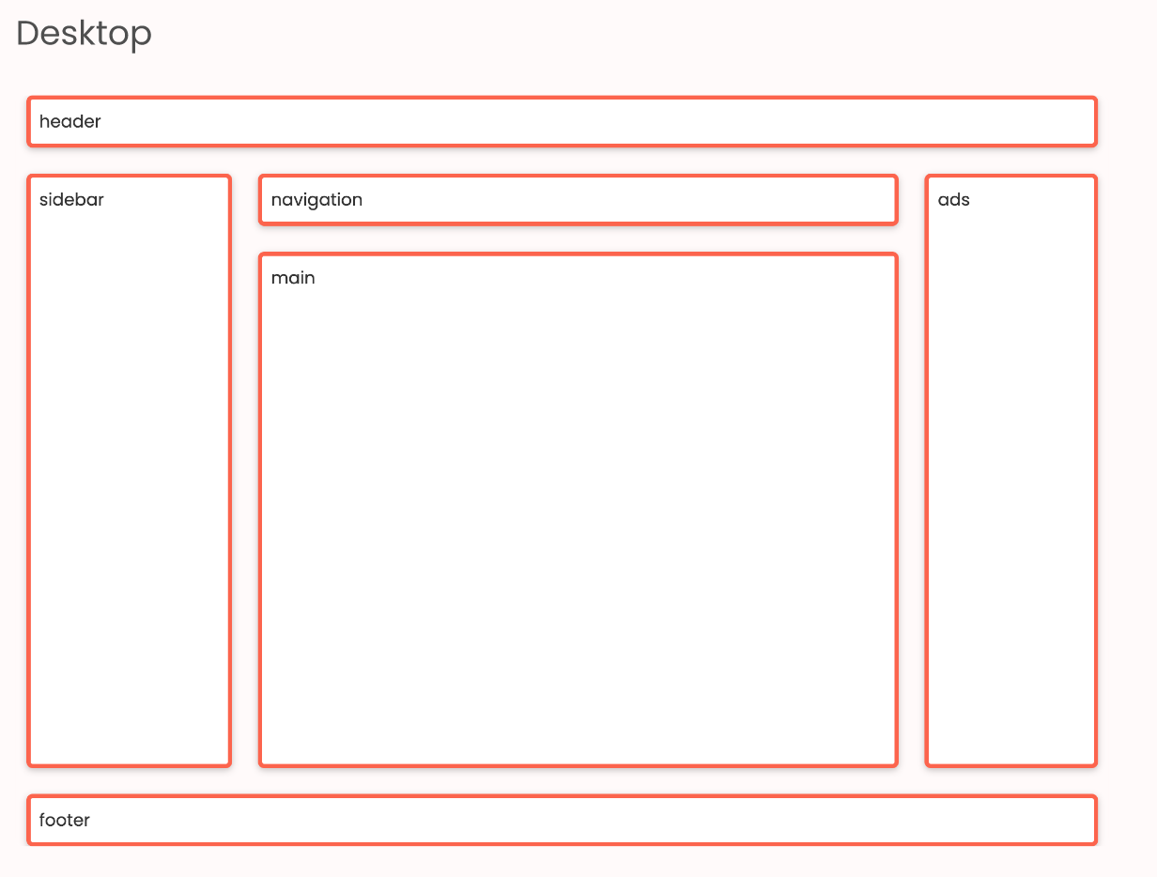
Exercise 4: Create this Layout (04-responsive-layout-grid)

